Slide 1
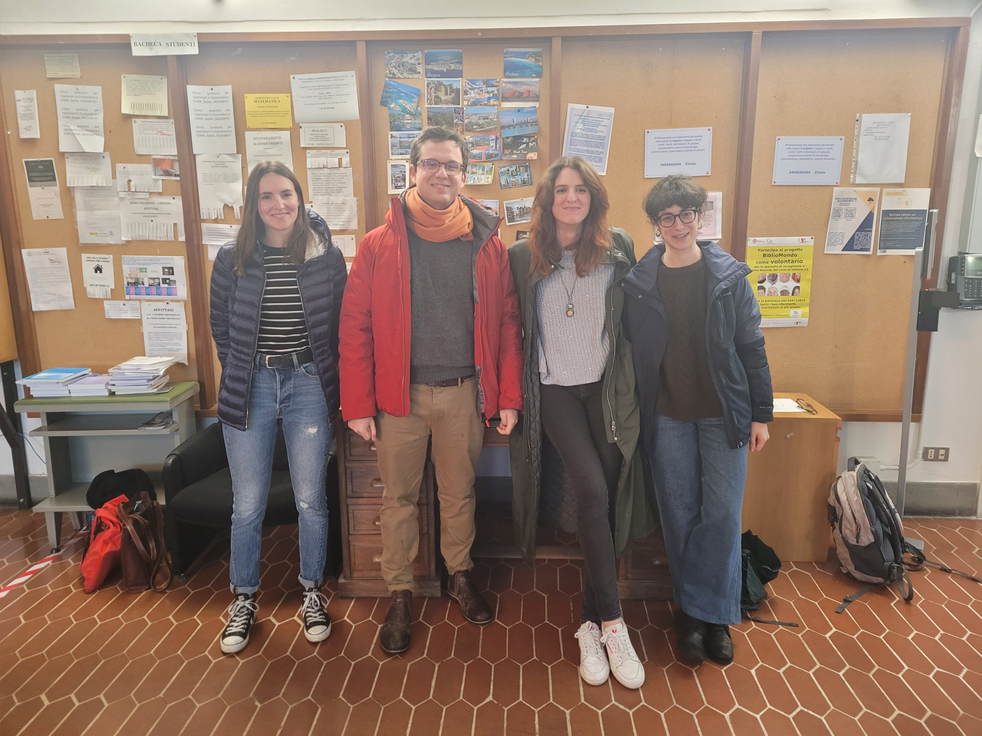
Team for Econometric Games 2022
Giulio Grossi – Ph.D. student in Statistics
Silvia Noirjean– Ph.D. student in Statistics
Emma Torrini – M.Sc. student Statistics
Noemi Walczak – M.Sc. student in Economics and Development
Hi! We are the team which will represent the University of Florence at the Econometric Games 2022 that will be held in Amsterdam in April. We are looking forward to start and get involved in this exciting econometric jam session!

